Slide 2
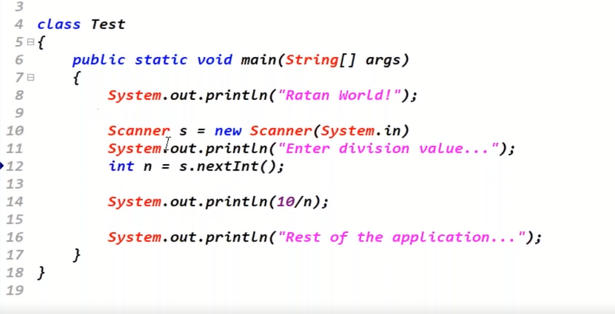
Taking a value from the user. The user may enter any value

Slide 3
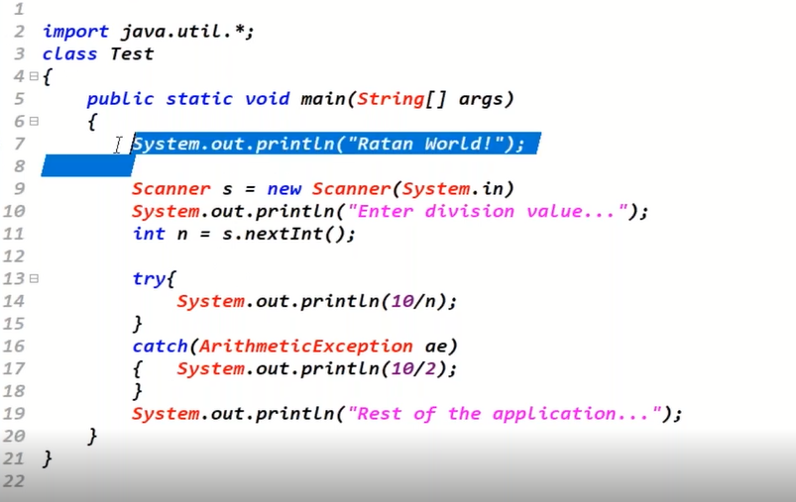
Now if the user can enter any value then we can have an exception also …. So we will write a try catch block for it.

Slide 4
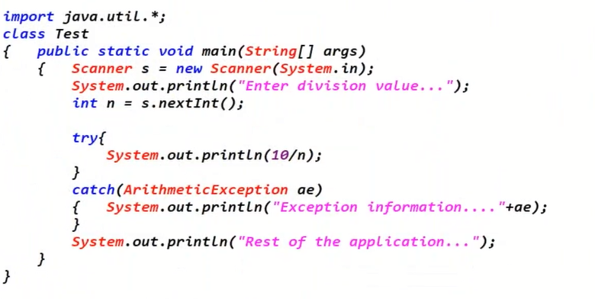
We can also use some information to be printed in the catch block by using the Exception object

Slide 5
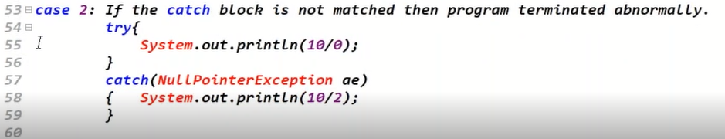

Slide 6
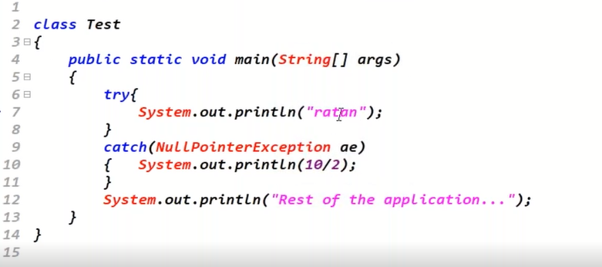
Case 3: If there is no exception in the try block, catch blocks are not checked

Slide 7
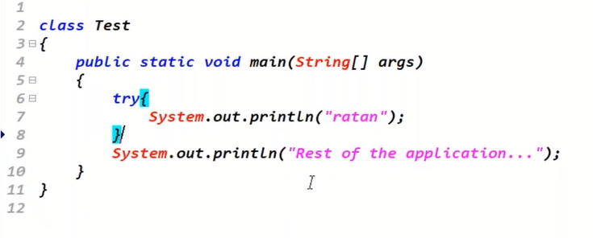
Case 4: Independent Try blocks are not allowed.

Slide 8
Case5: In between try and catch blocks the statements are not allowed.

Slide 9
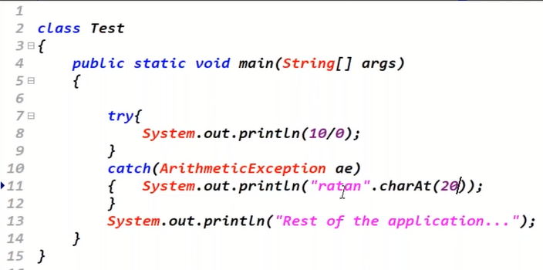
Case 6: If exception occurs in the catch block also then program terminates abnormally.

Slide 10
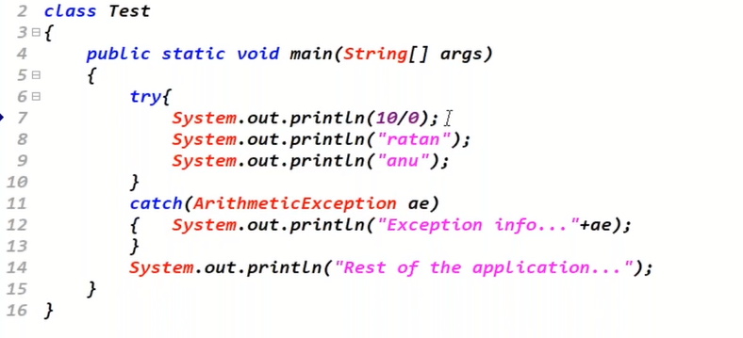
Case 7: If Exception occurs in the try block then the rest of the application will not be executed
Notes:
So do not put every thing inside the try and catch block.

Slide 11
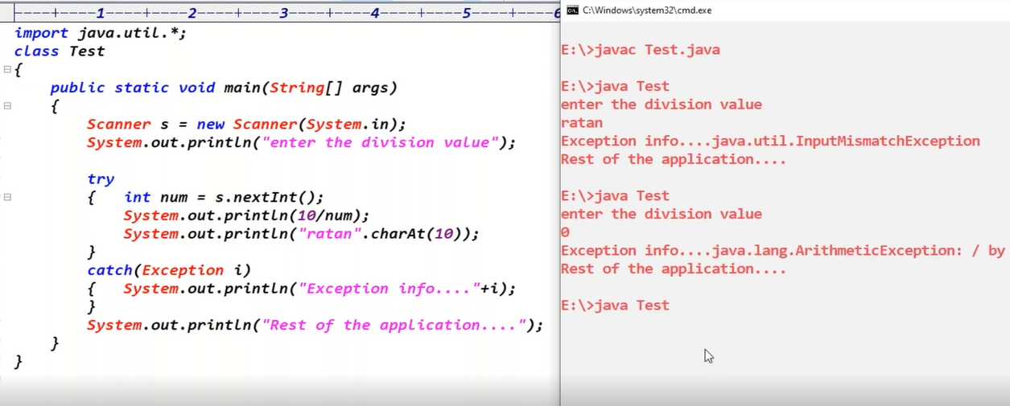
One Catch block handling all the Exceptions

Slide 12
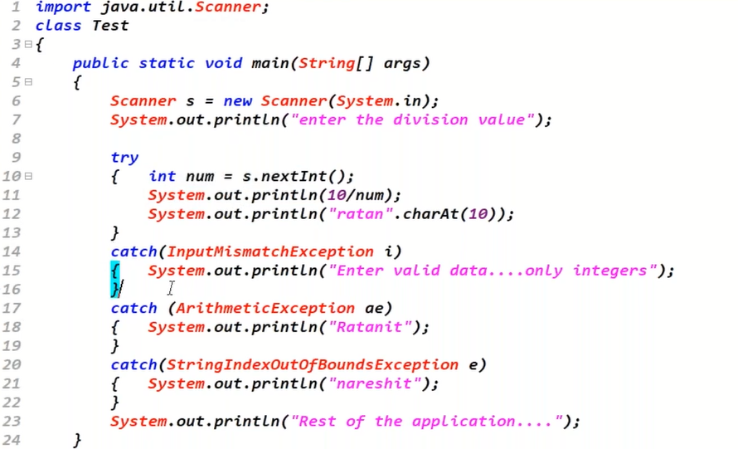
Different Catch blocks for different types of Exceptions in the same Try Block

Slide 13
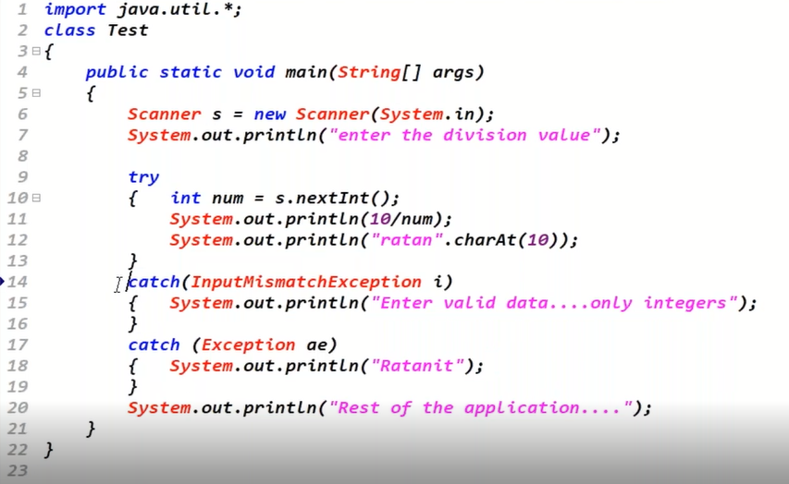
The order of Catch Blocks must to Child to Parent

Slide 14
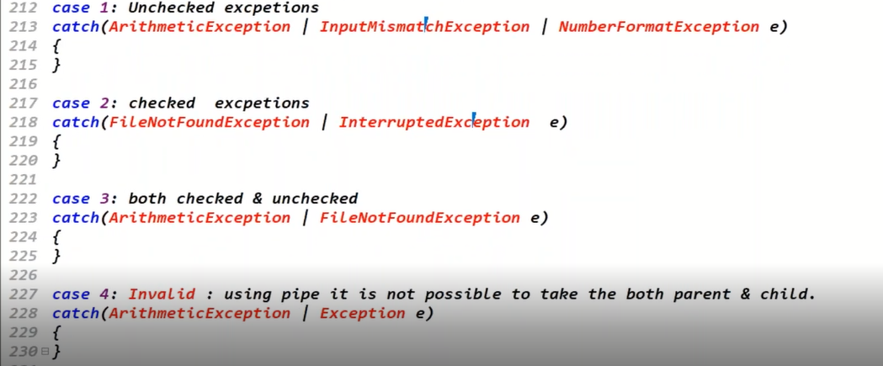
Using Single Catch for multiple Exceptions by using PIPE symbol

Slide 15
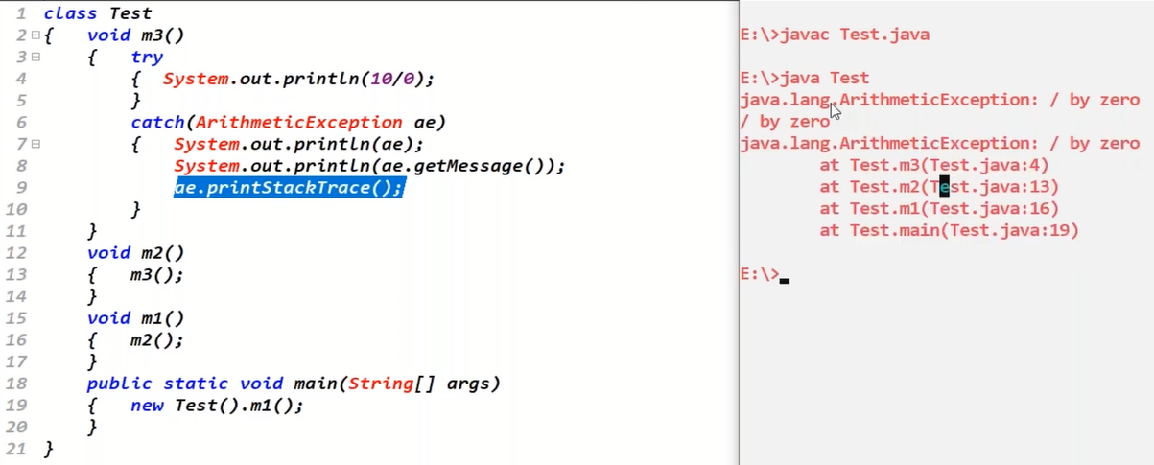
Complete Stack information using a built-in method

Slide 16
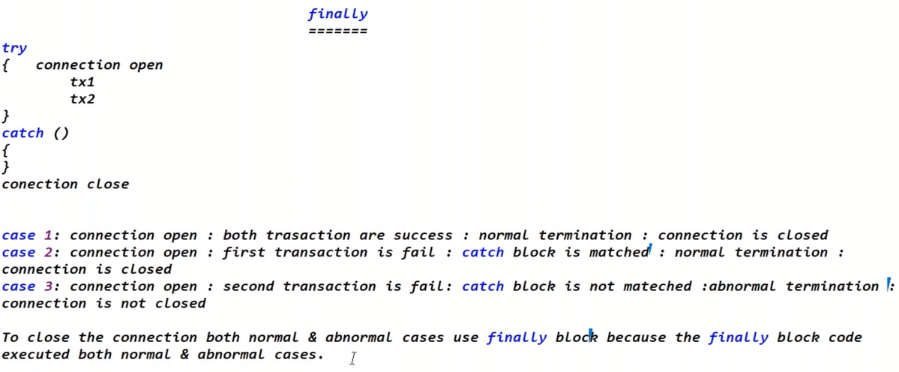
Finally, is used to release the resources, like to close the connections , scanner, files etc.

Slide 17
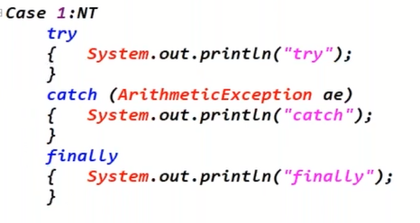
Case 1

Slide 19
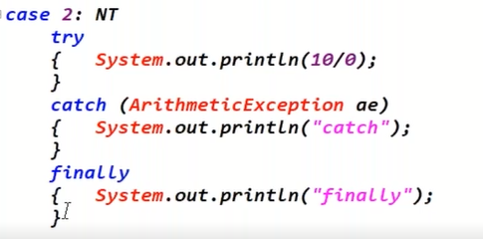
Case 2:

Slide 20
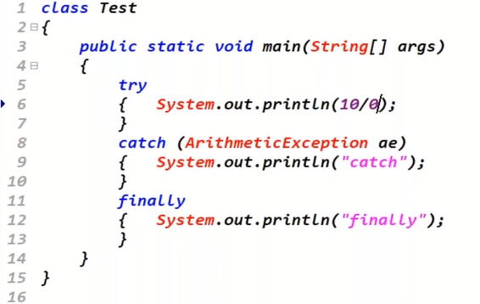

Slide 21
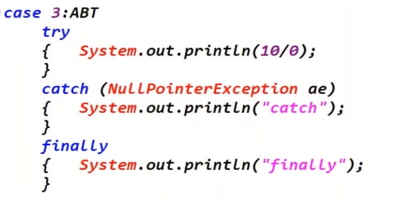
Case 3:

Slide 23
Case 4:

Slide 24
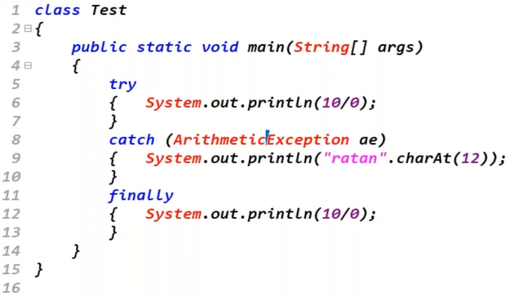
Case 5: Finally block can also have Exceptions

Slide 25
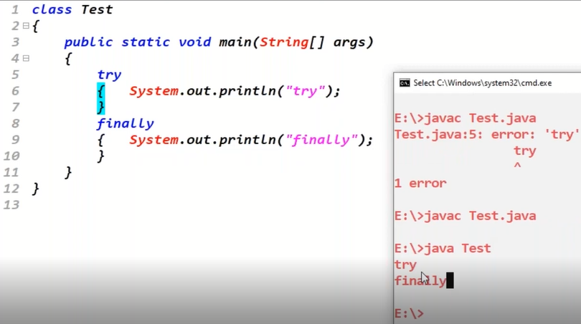
Case 6: Try with Finally only

Slide 26
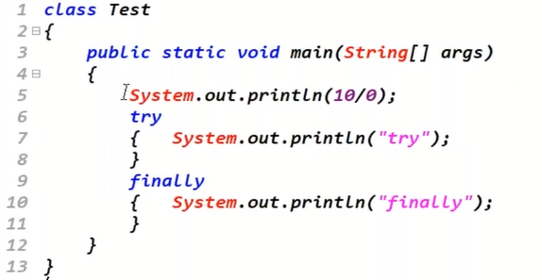
The Finally block is only executed when the Try block is started

Slide 27
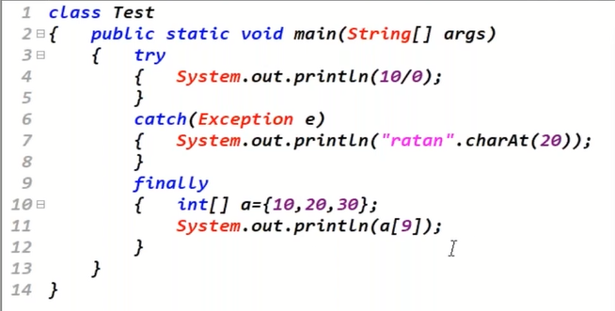
If every block has Exception then the JVM will only show one Exception at run time.

Slide 28
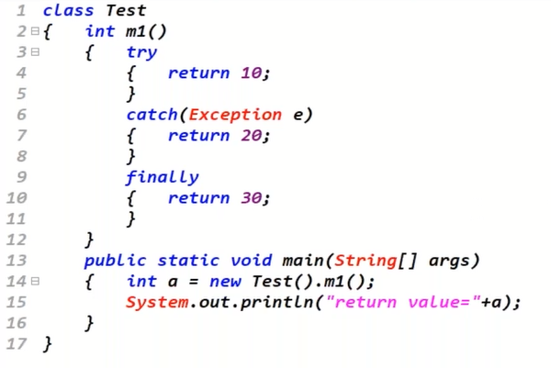
Another Example

Slide 29
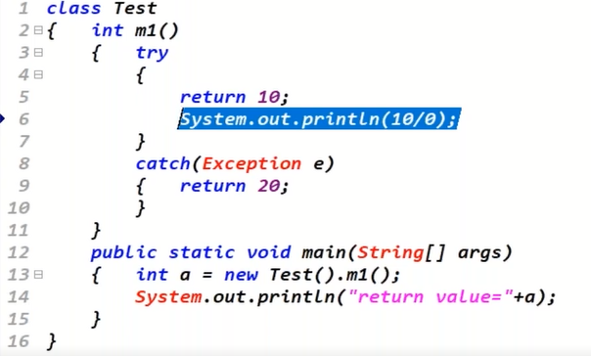
Inside the Block the return statement should be the last statement

Slide 30
The Finally block will not be executed in two cases.
When the jvm is shutdown.
When the try block is not started and we get an exception.

Slide 31
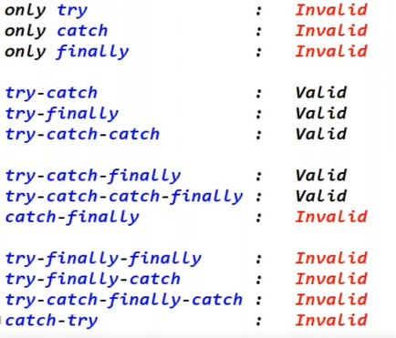
What is valid and invalid

